Slide 1

Final Phase Pitch Deck
Target Market
College institutions
Work organizations
Value Proposition
Individual Edition
Premium Edition
Enterprise Edition
Co-Founders
Ram Prasad Voleti
Alekhya Nangineni
Pranavi Adivi
Naga Nikhila Gonuguntla
Revanth Krishna Cherukuri
GaLa – Live every moment

Slide 2

Pain we are addressing
No specific platform to gather people for recreational activities in an institution/organization.
Lack of awareness.
No reminders in generic social media apps to encourage people to participate.
Difficulty in promoting the merchandises and tickets for related activities.

Slide 3

Our solution to the pain
In order to resolve this issue, we're creating a user-friendly platform for recreational services that can be accessed by many organizations and institutions.
We also encourage users to take part in any activities they find unique and interesting.
To raise awareness of upcoming events and current events, a news section is being added. Syncing their calendars and sending notifications will alert people, which increases their enthusiasm.
Also, we will reflect upon the highlights and summarize the activity.
Furthermore, we offer a marketplace where organizations may advertise their products, promotions, event tickets, etc.

Slide 4

Market Research
In our survey of around 300 universities in USA, majority lacks a centralized platform to bring people together for recreational activities.
General social-media applications are not serving the need and there is a potential for "GaLa" application here.
No competitor in the market who is currently addressing this pain.

Slide 5

Key winning features
News section for current and upcoming events.
Highlights regarding events and recreational activities.
Checklist to remind the necessary things
Forum section to discuss about the ongoing activities.
Calendar synchronization and mail alerts.
Marketplace for their products to advertise.
Notification alerts of upcoming events.

Slide 6
Capabilities
Participants can join events or activities according to their interests.
During events and activities, individuals are notified.
Calendar Synchronization of the events they join.
Provides a marketplace where institutions can promote their products.
News section provides information and helps in promoting the events.

Slide 7
JUSTIFICATION
Current market does not have a competitor to address this pain.
There is a huge need and demand for an application that facilitates the promoting and coordination of events.
There is a useful checklist feature that lets you keep track of what you need to bring to an activity.

Slide 8
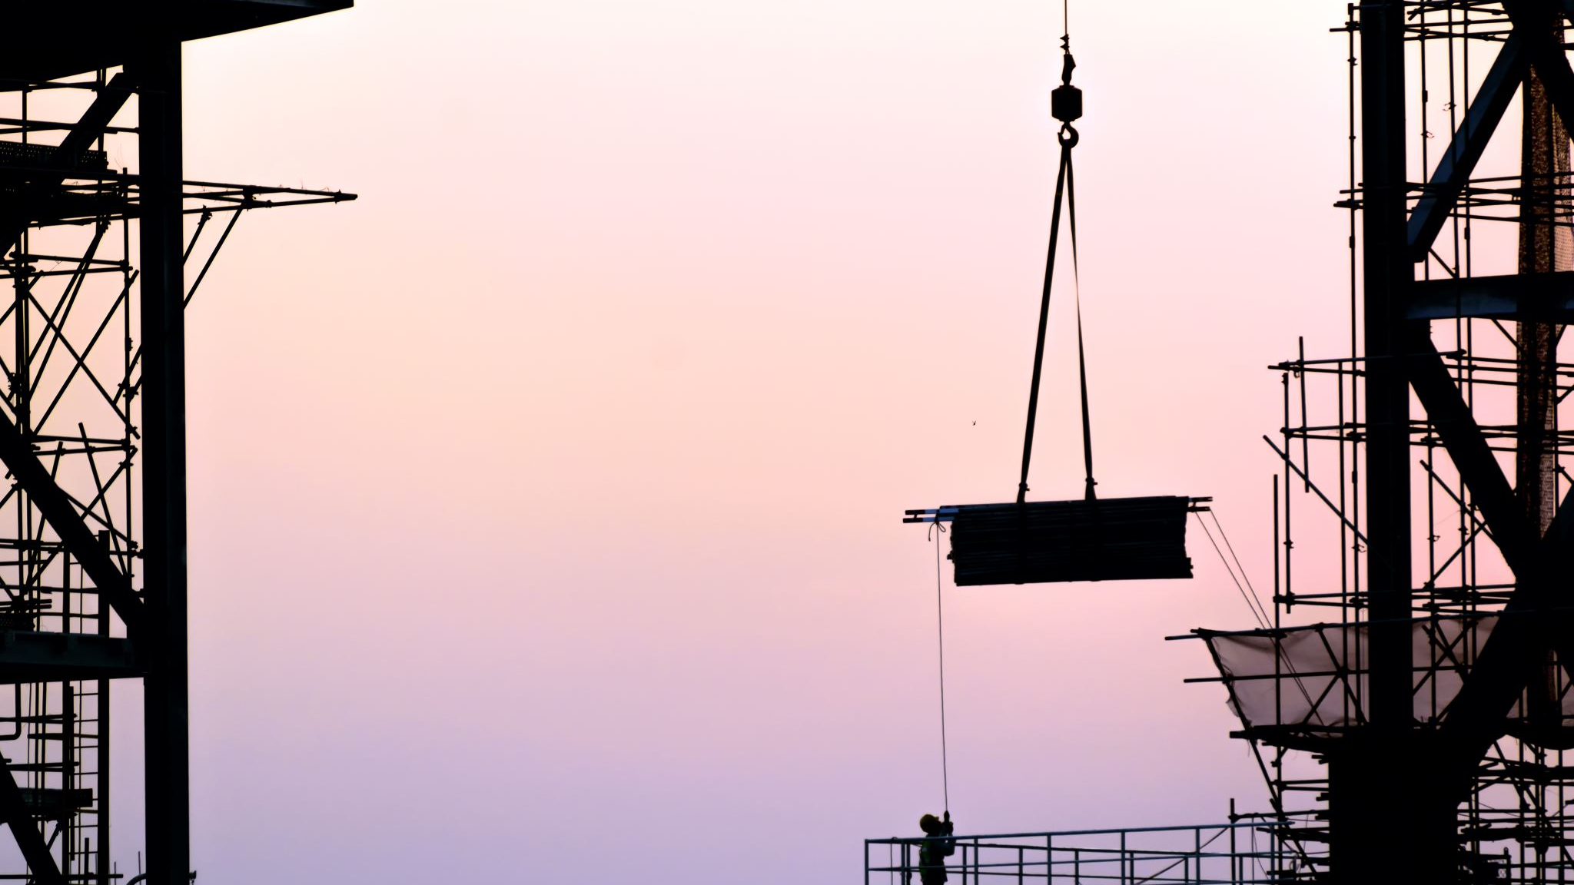
Current status
The project is live, and its URL is
https://gala-staging.herokuapp.com/
Working prototype is Enterprise edition with all premium features
Implemented News section feature to promote about activities.
Checklist feature is working to remind the users about items.
Product page to sell own merchandise, items, and event tickets.
Summary page which promotes the activity happened and can attract the users in participating in next events.
Group chat feature to interact with other participants.
Push notifications to email is yet to be implemented and it will roll out in next update.

Slide 9
Recorded Demo Video https://github.com/VoletiRam/GaLA/blob/main/live%20demo%203.mp4

Slide 10
Business Model
•We are providing freemium subscription model by inspiring from Microsoft and WebEx.
•We provide free service to individuals with basic features(can only add group members up to 20 and can create up to 10 groups).
•Premium features include no ads, marketplace to promote products and
merchandises, summary of group activity, unlimited number of users and groups.
•Enterprise edition for institutions and organizations where each will have premium features.
Making of Money
•Monthly subscription for premium features for individuals, $2 per month.
•For enterprise edition, we charge $1 per user/month.
If the institution has 2000 members, it will generate $2000 per month. In US alone, there is roughly 5000 universities/colleges and even if 40% universities uses our service, we are estimated to generate $70M per annum.

Slide 11
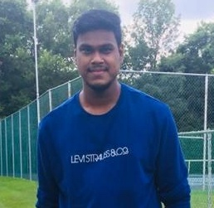
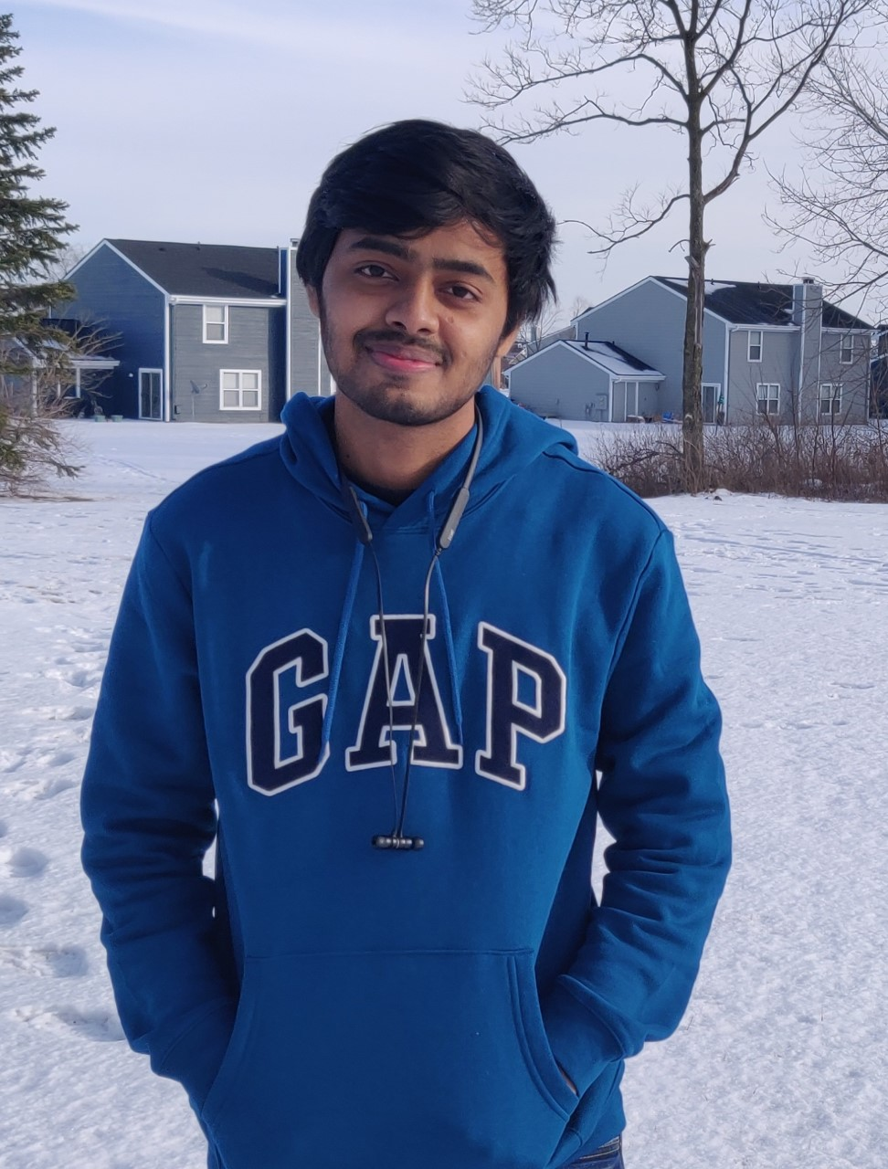
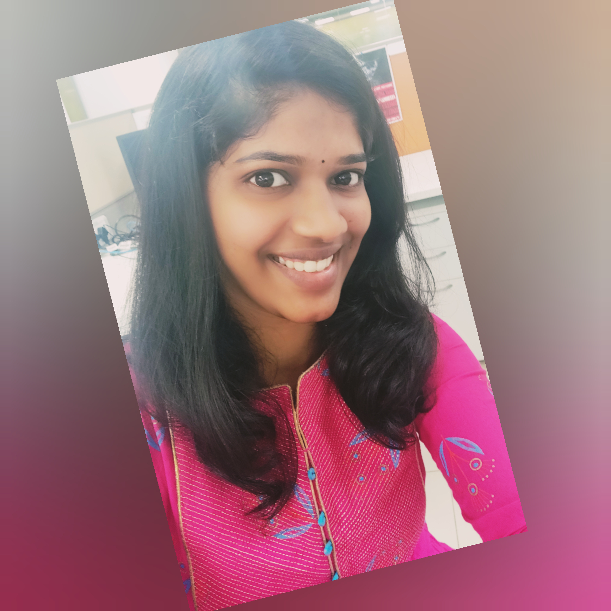
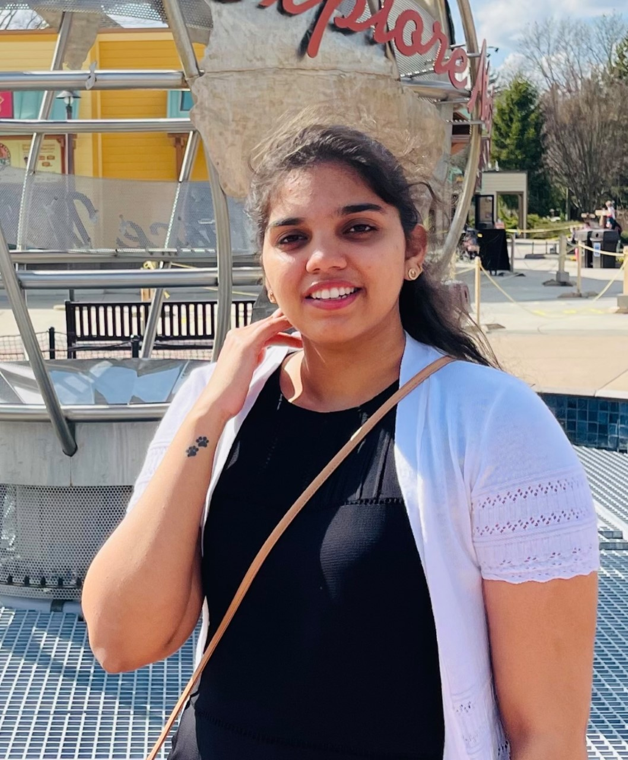
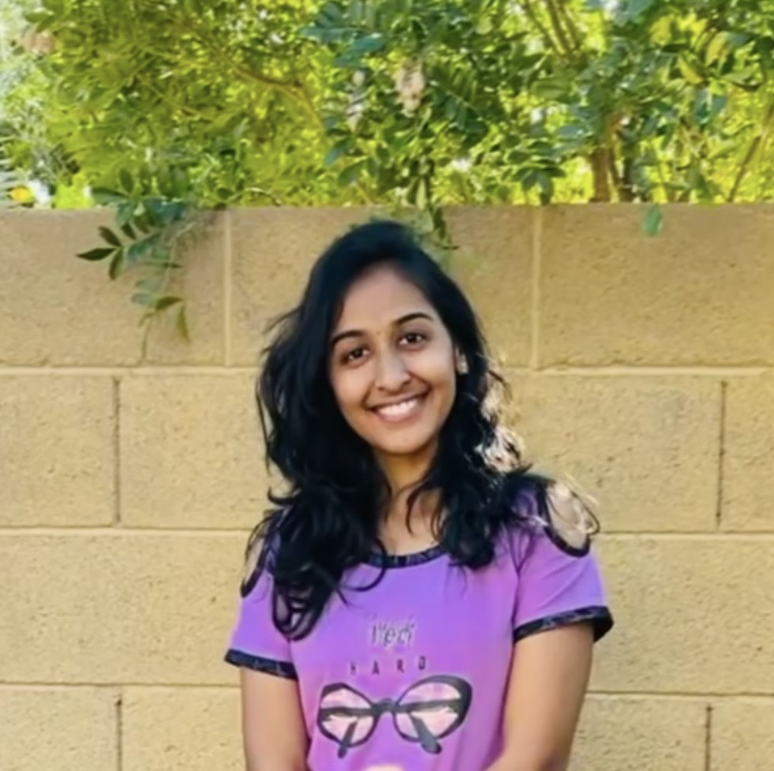
Team members and contribution Nikhila, Ram: Data Gathering & Identifying key features Alekhya, Revanth: Development & implementation of features Ram, Pranavi: Design User interface & Backend Nikhila, Alekhya, Revanth: Testing & validation Whole team: Deployment & Documentation
REVANTH
RAM PRASAD
ALEKHYA
PRANAVI
NIKHILA

Slide 12


